Slide 1
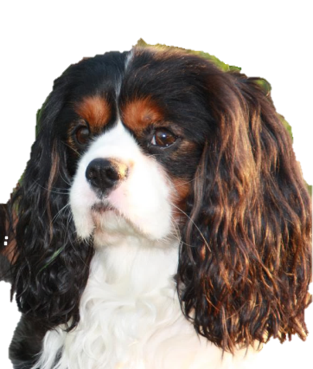
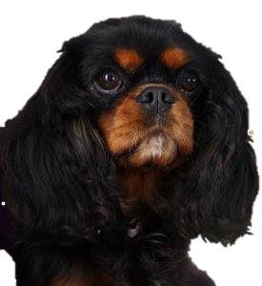
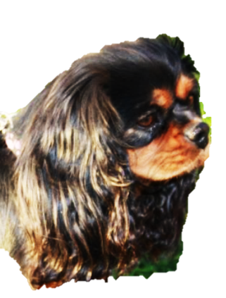
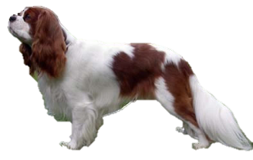
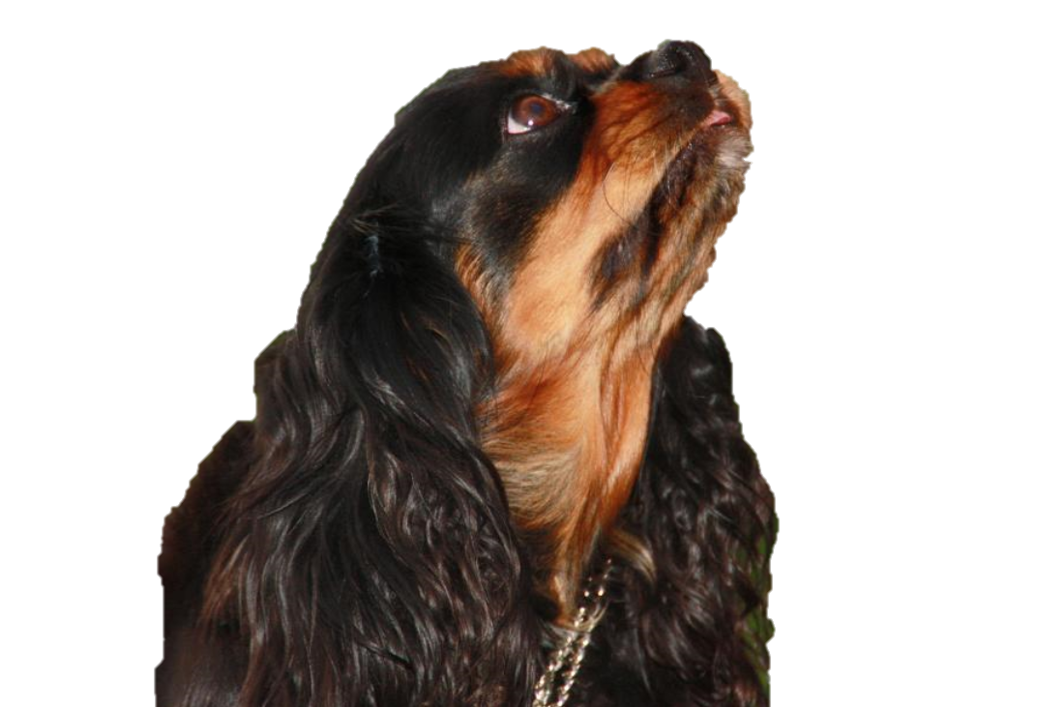
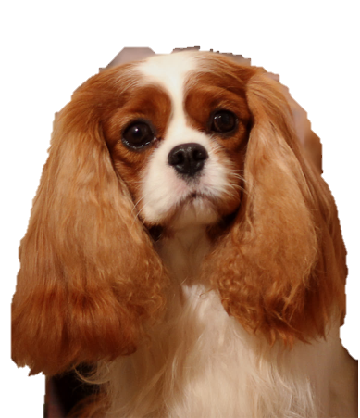
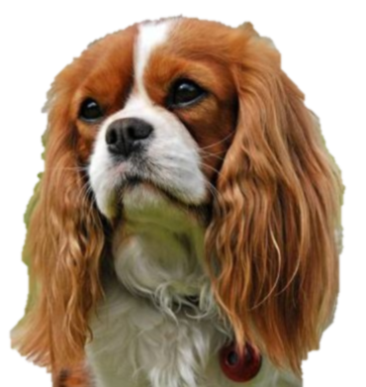
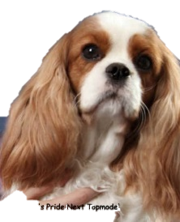
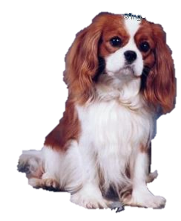
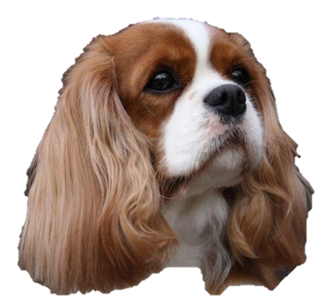
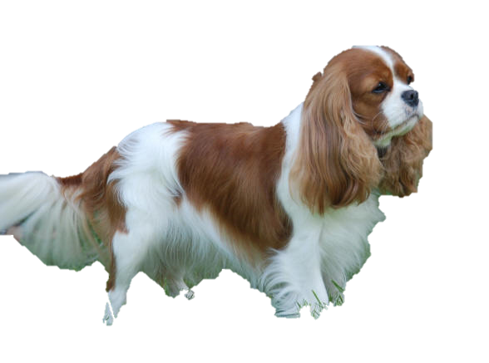
 | Foreldre: | Besteforeldre: | Oldeforeldre:
Vinbergets Lille John “Lilljohn”
Zolohouse
Beachcomber
Vouges Terrence “Terry”
Cemilies Godklump
“Bonnie”
f.15.10.2016
Vouges Hotmail (tricolor)
Vinbergets
Black Beauty
“Bella”
Lyalands Rooney The Loony “Simon”
Encos Carmencitha (Cita)
CH Angel's Pride Benjamin
Button
Maibee Moffat
“Johnny”
Ch. Angel's Pride
Next Topmodel
“Heidi”
DUCH CH Angel’s
Pride Jasmin
”Jasmin”
Sanicro Escapade
RL1 Chivalrous's Vida Vanette "Irma"
CH. Angel’s Pride Anastacia

